Slide 1
0
10
Photosynthesis
Lecture Presentation by Nicole Tunbridge and
Kathleen Fitzpatrick

Slide 2
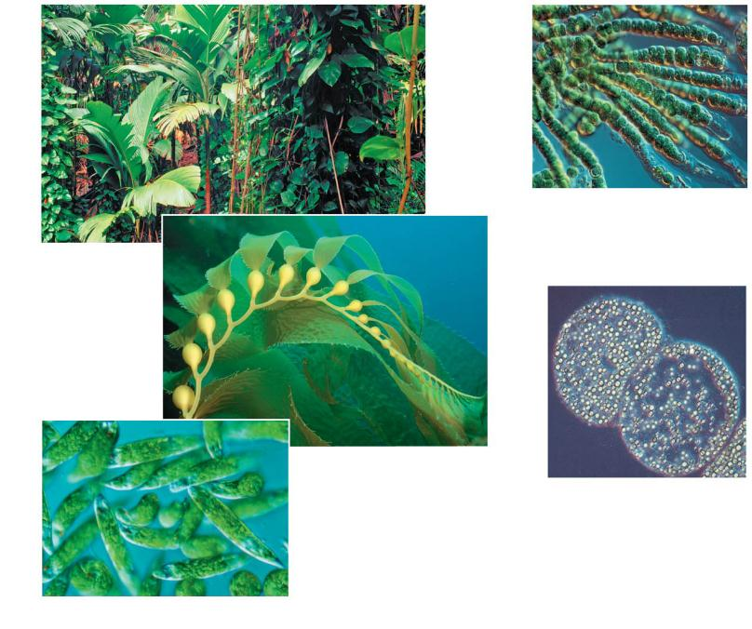
Figure 10.2
(d) Cyanobacteria
40
μm
(a) Plants
(b) Multicellular alga
1 μm
(e) Purple sulfur
bacteria
10 μm
(c) Unicellular eukaryotes
Notes:
Figure 10. 2 Photoautotrophs

Slide 3
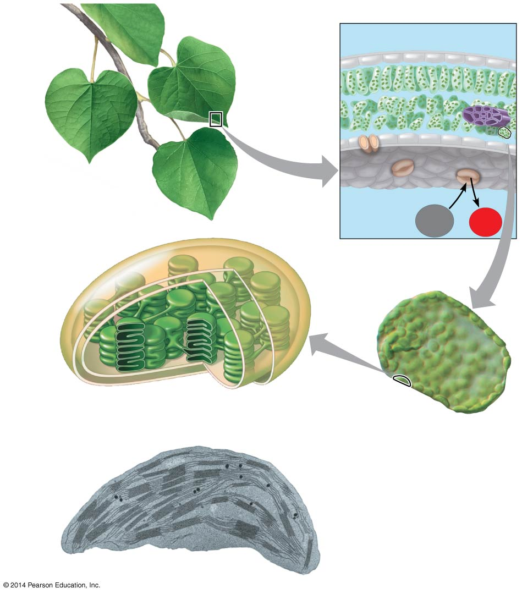
Figure 10.4
Leaf cross section
Chloroplasts
Vein
Mesophyll
Stomata
CO₂
O₂
Chloroplast
Mesophyll
cell
Outer
membrane
Thylakoid
Thylakoid
space
Intermembrane
space
Stroma
Granum
20 μm
Inner
membrane
1 μm
Notes:
Figure 10.4 Zooming in on the location of photosynthesis in a plant

Slide 4
Figure 10.5
Reactants:
6 CO₂
12 H₂O
Products:
C₆H₁₂O₆
6 H₂O
6 O₂
Notes:
Figure 10.5 Tracking atoms through photosynthesis

Slide 5
Figure 10.UN01
becomes reduced
becomes oxidized
Notes:
Figure 10.UN01 In-text figure, photosynthesis equation, p. 189

Slide 6
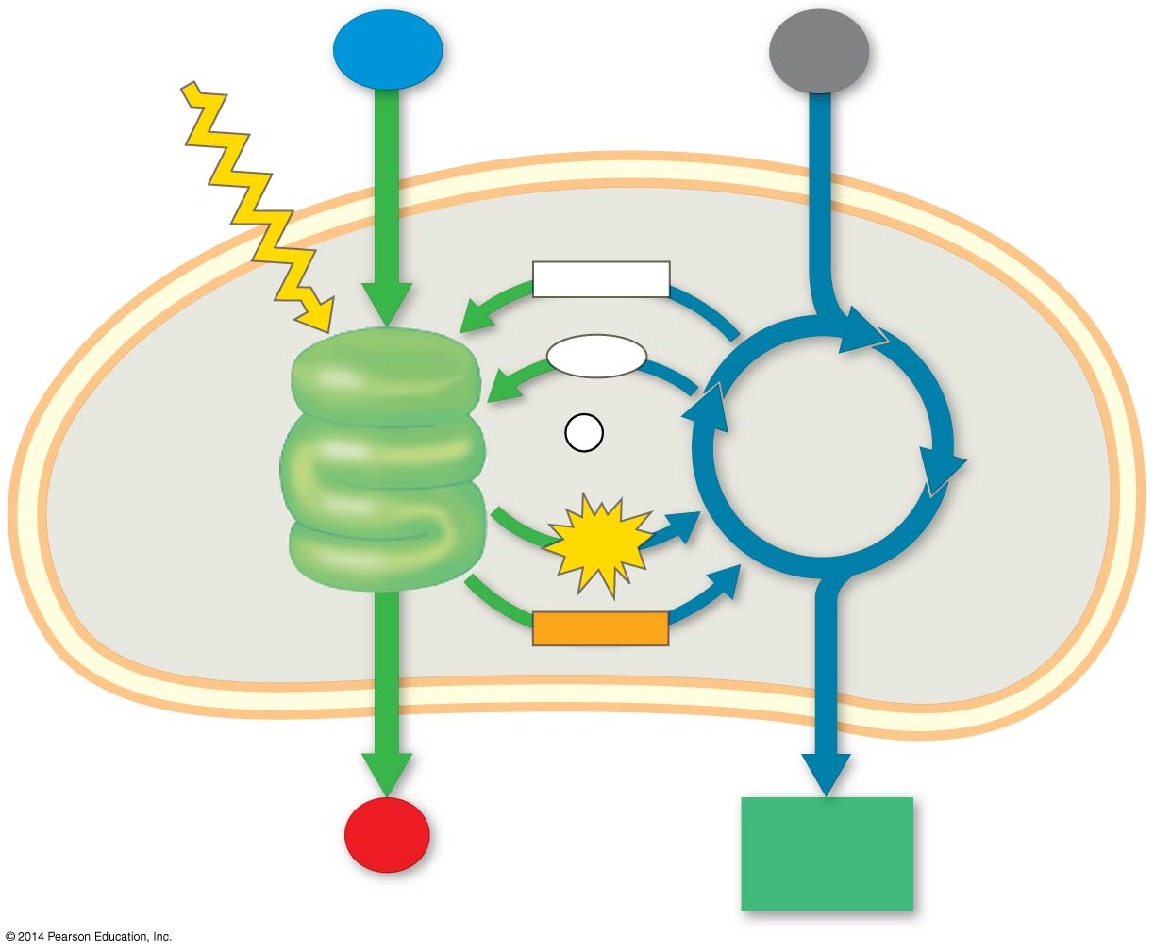
Figure 10.6-4
Light
H₂O
CO₂
NADP⁺
ADP
+
LIGHT
REACTIONS
P _{i}
CALVIN
CYCLE
ATP
Stroma
Thylakoid
NADPH
Chloroplast
O₂
[CH₂O]
(sugar)
Notes:
Figure 10.6-4 An overview of photosynthesis: cooperation of the light reactions and the Calvin cycle (step 4)

Slide 7
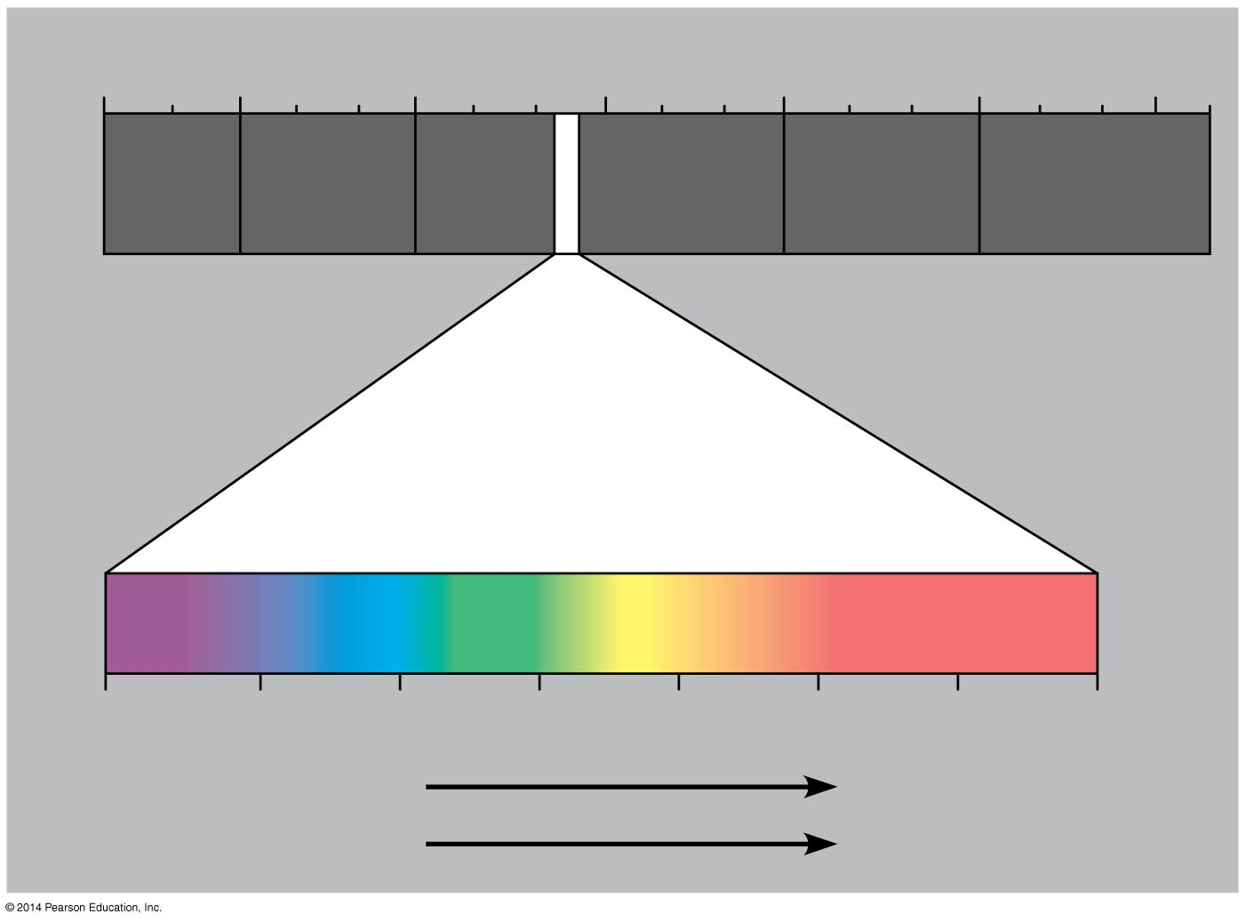
Figure 10.7
1 m
10⁻
nm
10⁻
nm
1 nm
10
nm
10
nm
(10
nm)
10
m
⁵
³
³
⁶
⁹
³
Gamma
rays
Micro-
waves
Radio
waves
X-rays
UV
Infrared
Visible light
380
450
500
550
600
650
700
750
nm
Shorter wavelength
Longer wavelength
Higher energy
Lower energy
Notes:
Figure 10.7 The electromagnetic spectrum

Slide 8
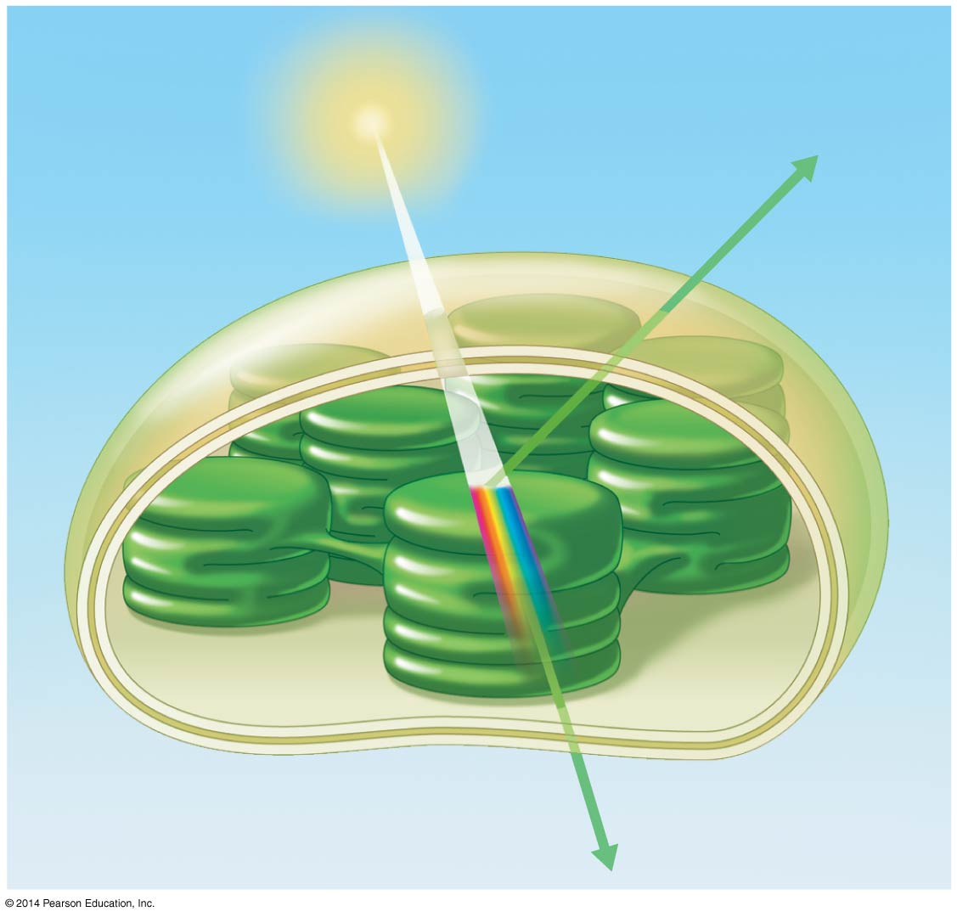
Figure 10.8
Light
Reflected
light
Chloroplast
Absorbed
light
Granum
Transmitted
light
Notes:
Figure 10.8 Why leaves are green: interaction of light with chloroplasts

Slide 9
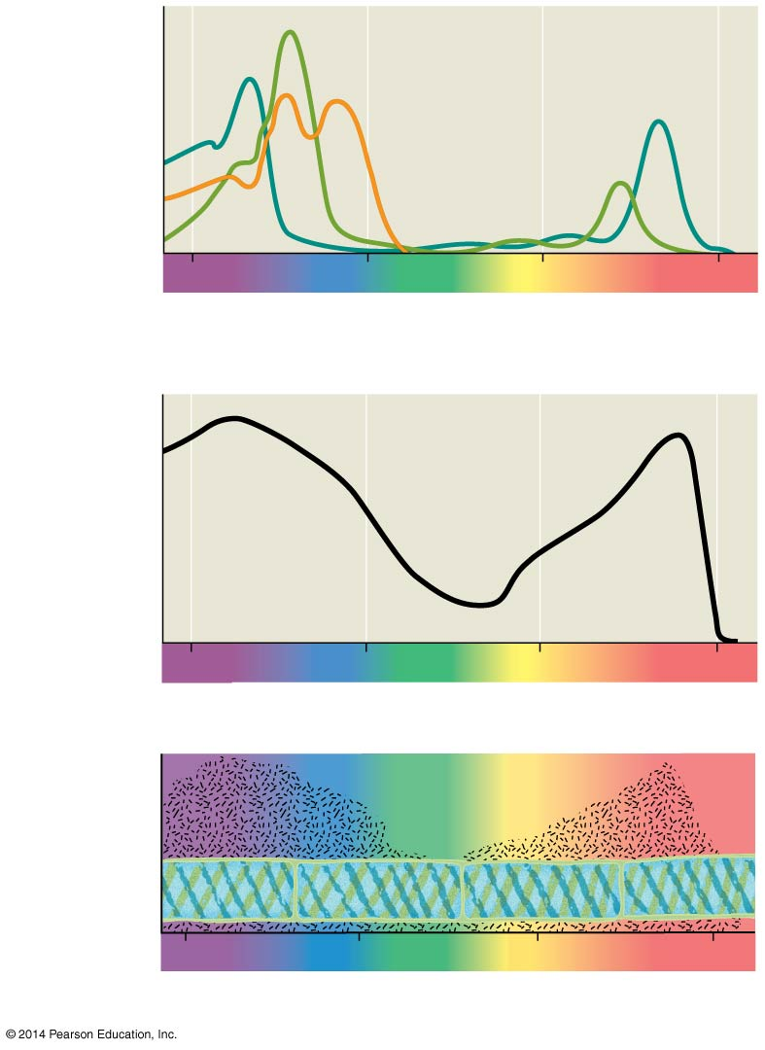
Figure 10.10
Chloro-
phyll a
Absorption
of light by
chloroplast
pigments
Chlorophyll b
Carotenoids
400
500
600
700
Wavelength of light (nm)
(a) Absorption spectra
Rate of
photosynthesis
(measured by O₂
release)
400
500
600
700
(b) Action spectrum
Aerobic bacteria
Filament of alga
400
500
600
700
(c) Engelmann’s experiment
Notes:
Figure 10.10 Inquiry: Which wavelengths of light are most effective in driving photosynthesis?

Slide 10
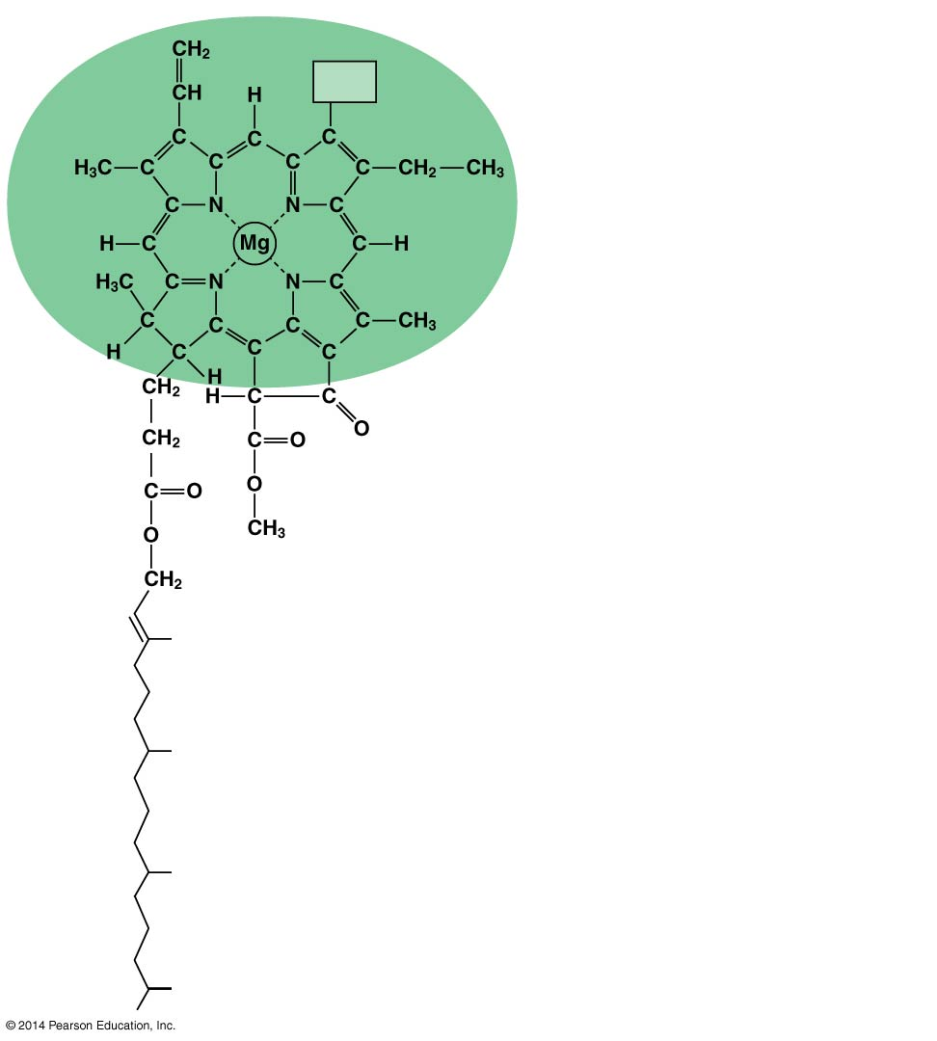
Figure 10.11
CH
in chlorophyll a
3
CH
3
CHO
in chlorophyll b
Porphyrin ring:
light-absorbing
“head” of molecule;
note magnesium
atom at center
Hydrocarbon tail:
interacts with hydrophobic
regions of proteins inside
thylakoid membranes of
chloroplasts; H atoms not
shown
Notes:
Figure 10.11 Structure of chlorophyll molecules in chloroplasts of plants

Slide 11
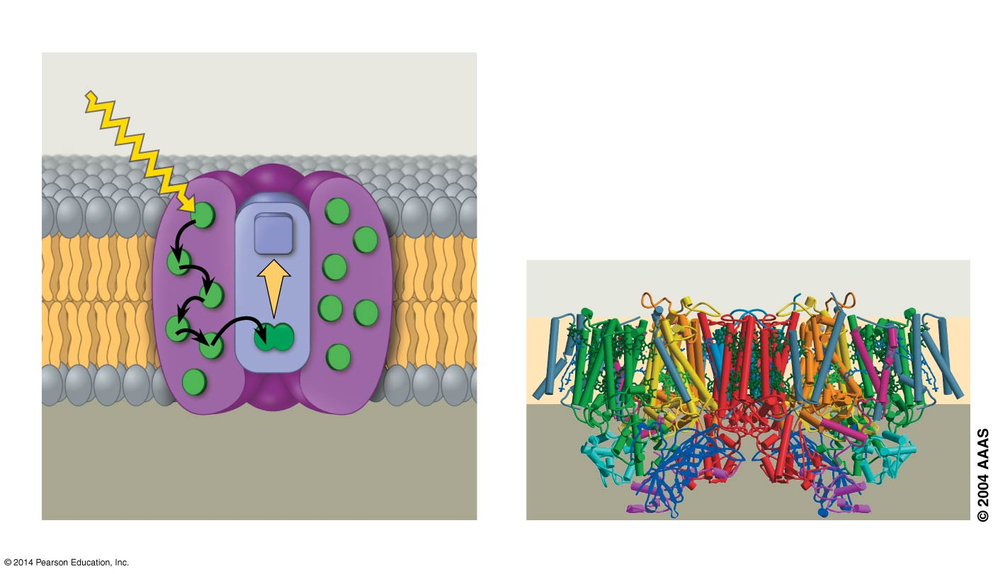
Figure 10.13
Photosystem
Photon
Light-
harvesting
complexes
Reaction-
center
complex
STROMA
Primary
electron
acceptor
e⁻
Chlorophyll
STROMA
Thylakoid membrane
Thylakoid membrane
Transfer
of energy
Special pair of chloro-
phyll a molecules
Pigment
molecules
THYLA-
KOID SPACE
THYLAKOID SPACE
(INTERIOR OF THYLAKOID)
Protein
subunits
(a) How a photosystem harvests light
(b) Structure of a photosystem
Notes:
Figure 10.13 The structure and function of a photosystem

Slide 12
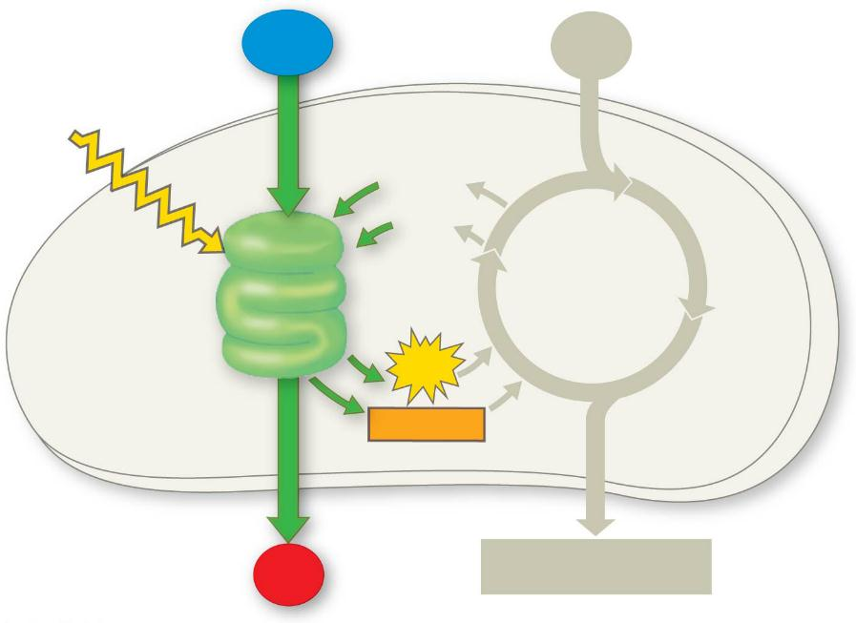
Figure 10.UN02
H₂O
CO₂
Light
NADP⁺
ADP
CALVIN
CYCLE
LIGHT
REACTIONS
ATP
NADPH
O₂
[CH₂O] (sugar)
Notes:
Figure 10.UN02 In-text figure, light reaction schematic, p. 195

Slide 13
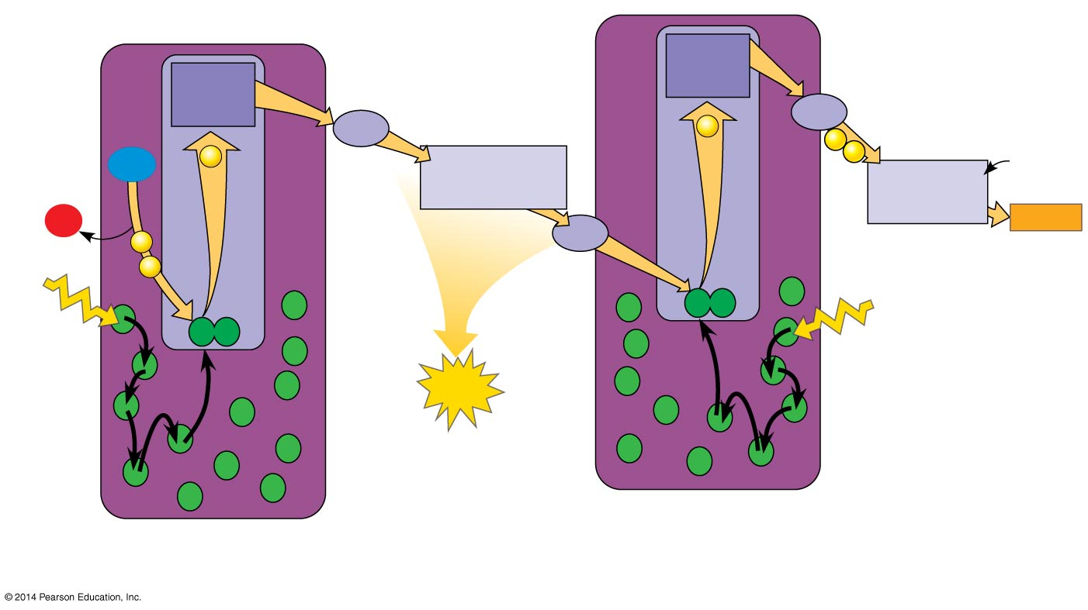
Figure 10.14-5
4
Electron
transport
chain
7
Electron
transport
chain
Primary
acceptor
Primary
acceptor
Pq
e⁻
Fd
2
e⁻
8
NADP⁺
+ H⁺
2 H⁺
e⁻
e⁻
+
H₂O
Cytochrome
complex
NADP⁺
reductase
½
O₂
3
NADPH
e⁻
Pc
P700
1
e⁻
P680
5
Light
Light
6
ATP
Pigment
molecules
Photosystem I
(PS I)
Photosystem II
(PS II)
Notes:
Figure 10.14-5 How linear electron flow during the light reactions generates ATP and NADPH (step 5)

Slide 14
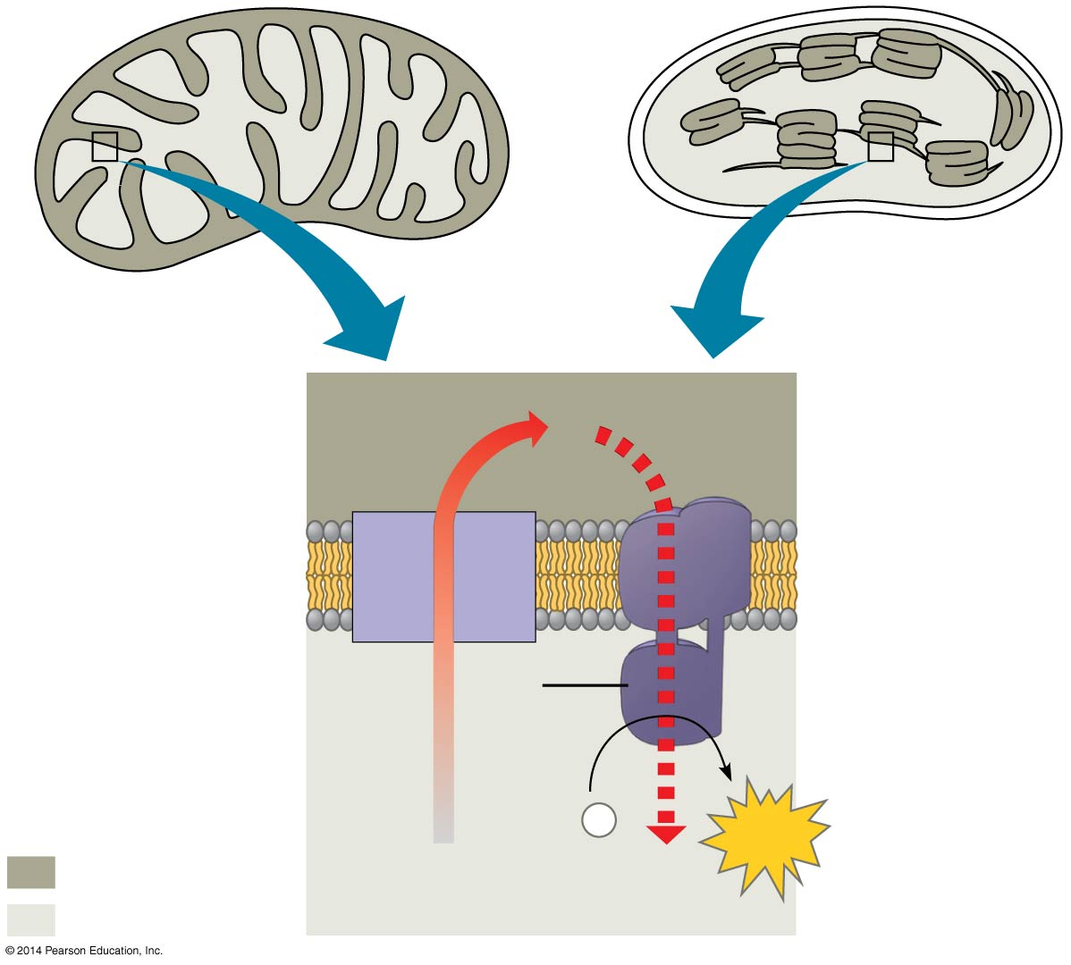
Figure 10.17
MITOCHONDRION
STRUCTURE
CHLOROPLAST
STRUCTURE
Inter-
membrane
space
H⁺
Diffusion
Thylakoid
space
Inner
membrane
Electron
transport
chain
Thylakoid
membrane
ATP
synthase
Matrix
Stroma
Key
ADP +
P
ATP
i
Higher [H⁺]
H⁺
Lower [H⁺]
Notes:
Figure 10.17 Comparison of chemiosmosis in mitochondria and chloroplasts

Slide 15
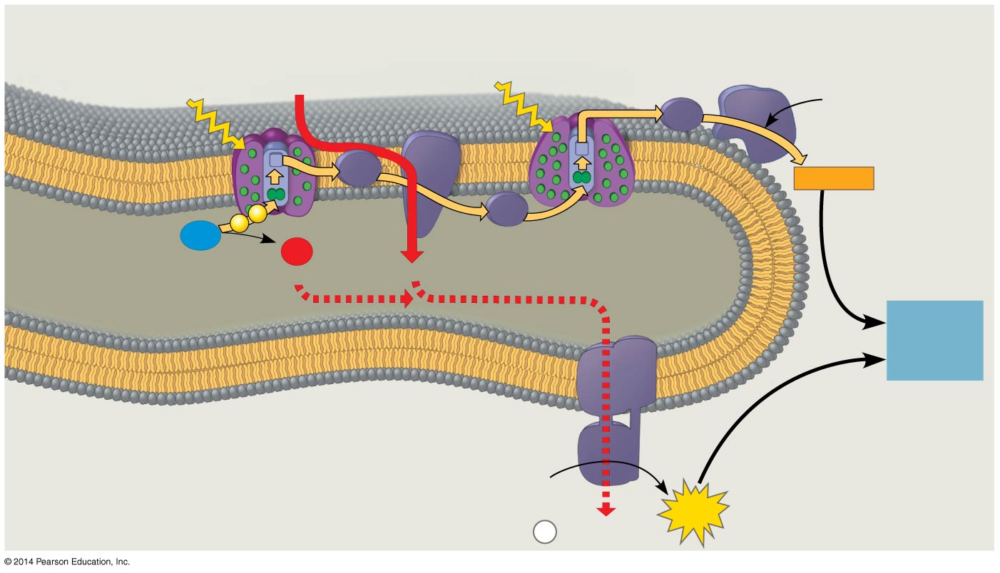
Figure 10.18
Photosystem II
Cytochrome
complex
Photosystem I
NADP⁺
reductase
4 H⁺
Light
3
Light
NADP⁺
+ H⁺
Fd
Pq
NADPH
e⁻
e⁻
2
Pc
H₂O
1
O₂
THYLAKOID SPACE
(high H⁺ concentration)
½
+2 H⁺
4 H⁺
To
Calvin
Cycle
Thylakoid
membrane
ATP
synthase
STROMA
(low H⁺ concentration)
ADP
+
ATP
P
H⁺
i
Notes:
Figure 10.18 The light reactions and chemiosmosis: Current model of the organization of the thylakoid membrane

Slide 16
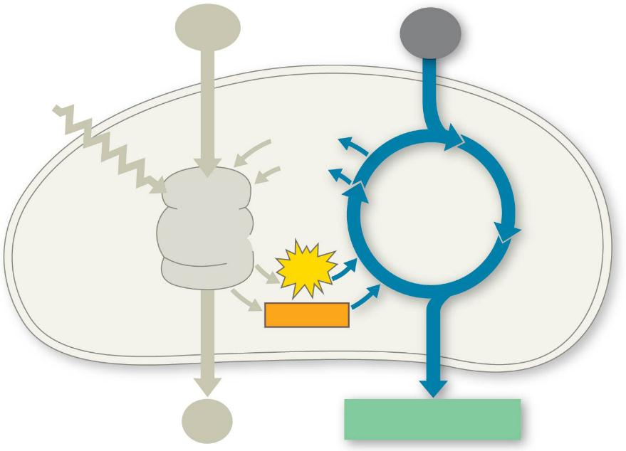
Figure 10.UN03
H₂O
CO₂
Light
NADP⁺
ADP
CALVIN
CYCLE
LIGHT
REACTIONS
ATP
NADPH
O₂
[CH₂O] (sugar)
Notes:
Figure 10.UN03 In-text figure, Calvin cycle schematic, p. 200

Slide 17
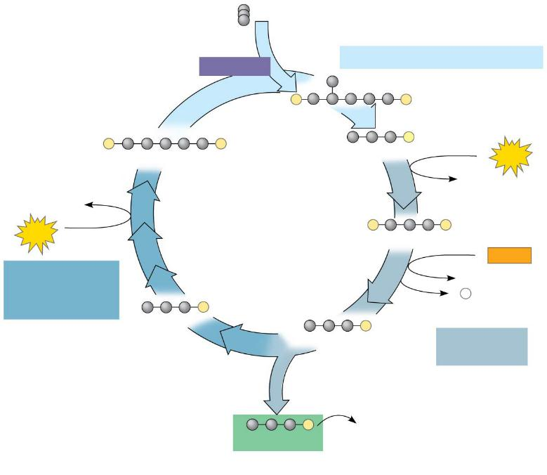
Figure 10.19-3
Input 3 CO₂, entering one per cycle
Phase 1: Carbon fixation
Rubisco
3
P
P
3
P
P
6
P
RuBP
3-Phosphoglycerate
6
ATP
6 ADP
3 ADP
Calvin
Cycle
3
ATP
6
P
P
1,3-Bisphosphoglycerate
6
NADPH
Phase 3:
Regeneration
of RuBP
6 NADP⁺
6
P
5
P
i
G3P
6
P
G3P
Phase 2:
Reduction
1
P
Glucose and
other organic
compounds
G3P
Output
Notes:
Figure 10.19-3 The Calvin cycle (step 3)

Slide 18
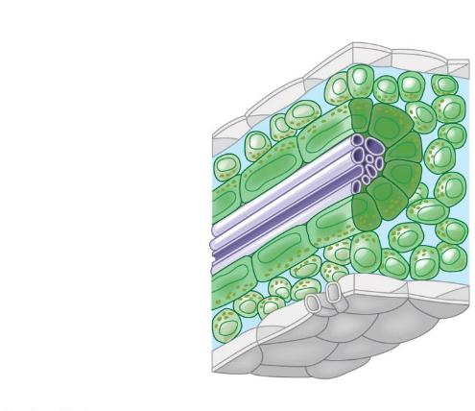
Figure 10.20a
C₄ leaf anatomy
Photo-
synthetic
cells of
C₄ plant
leaf
Mesophyll
cell
Bundle-
sheath
cell
Vein
(vascular
tissue)
Stoma
Notes:
Figure 10.20a C₄ leaf anatomy and the C₄ pathway (part 1: leaf anatomy)

Slide 19
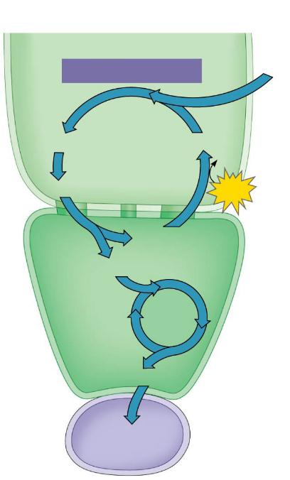
Figure 10.20b
The C₄ pathway
Mesophyll
cell
PEP carboxylase
CO₂
Oxaloacetate (4C)
PEP (3C)
ADP
Malate (4C)
ATP
Pyruvate (3C)
CO₂
Bundle-
sheath
cell
Calvin
Cycle
Sugar
Vascular
tissue
Notes:
Figure 10.20b C₄ leaf anatomy and the C₄ pathway (part 2: pathway)

Slide 20
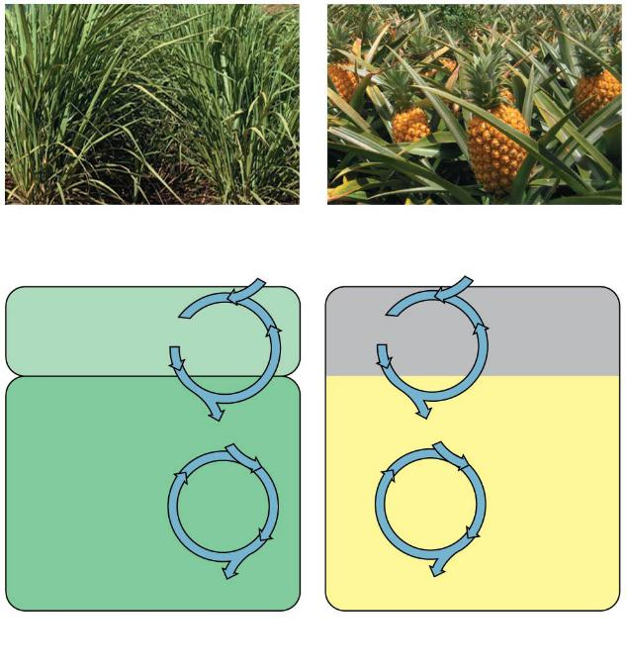
Figure 10.21
Sugarcane
Pineapple
C₄
1
CO₂
1
CAM
CO₂
Mesophyll
cell
Organic
acid
Organic
acid
Night
CO₂
2
CO₂
2
Bundle-
sheath
cell
Day
Calvin
Cycle
Calvin
Cycle
Sugar
Sugar
(a) Spatial separation of steps
(b) Temporal separation of steps
Notes:
Figure 10.21 C₄ and CAM photosynthesis compared

Slide 21
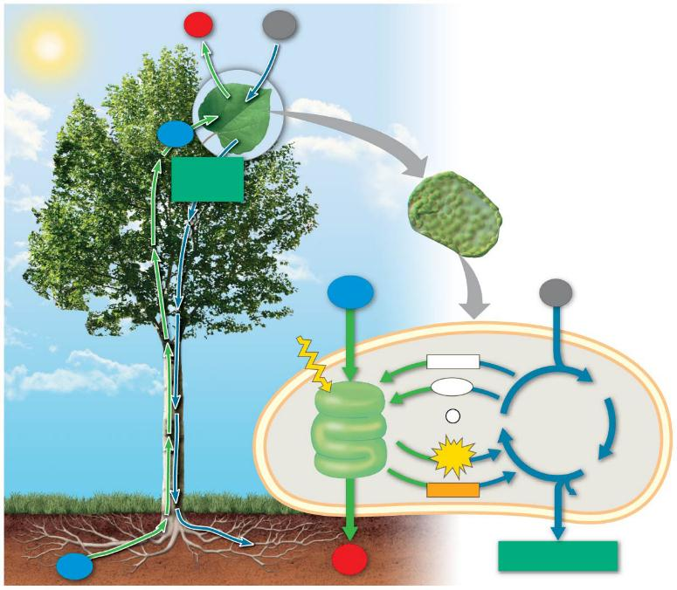
Figure 10.22a
O₂
CO₂
H₂O
Sucrose
(export)
Mesophyll cell
H₂O
Chloroplast
CO₂
Light
NADP⁺
ADP
3-Phosphoglycerate
LIGHT
REACTIONS: Photosystem II
Electron transport
chain
+
P
RuBP
CALVIN
CYCLE
i
ATP
G3P
Photosystem I
Electron transport
chain
NADPH
Starch
(storage)
H₂O
O₂
Sucrose (export)
Notes:
Figure 10.22a A review of photosynthesis (part 1)

Slide 22
Figure 10.22b
LIGHT REACTIONS
CALVIN CYCLE REACTIONS
Are carried out by molecules in the thylakoid membranes
Take place in the stroma
Use ATP and NADPH to convert CO₂ to the sugar G3P
Convert light energy to the chemical energy of ATP and NADPH
Return ADP, inorganic phosphate, and NADP⁺ to the light reactions
Split H₂O and release O₂ to the atmosphere
Notes:
Figure 10.22b A review of photosynthesis (part 2)

