Slide 1
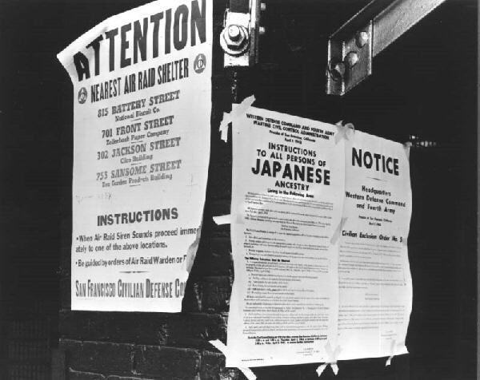

Slide 2
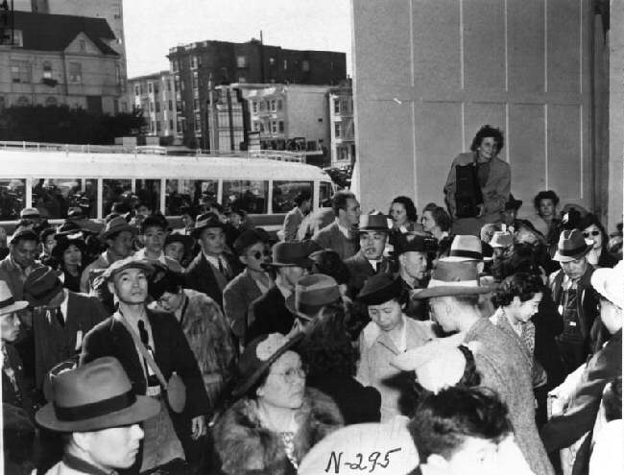

Slide 3
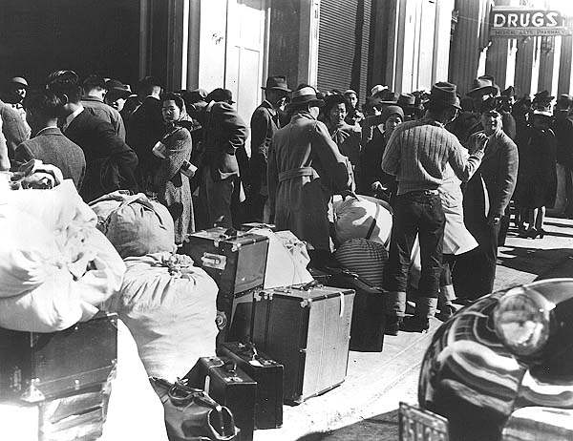

Slide 4
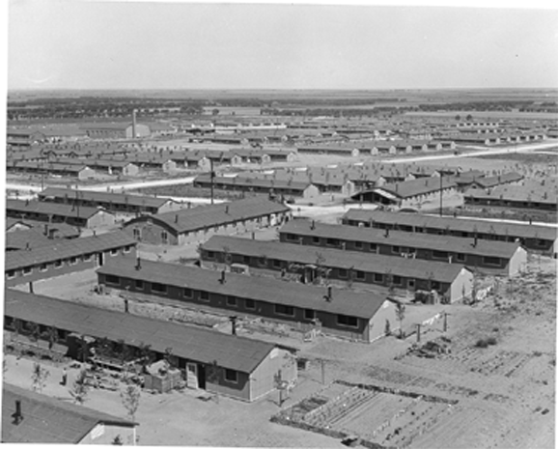

Slide 5
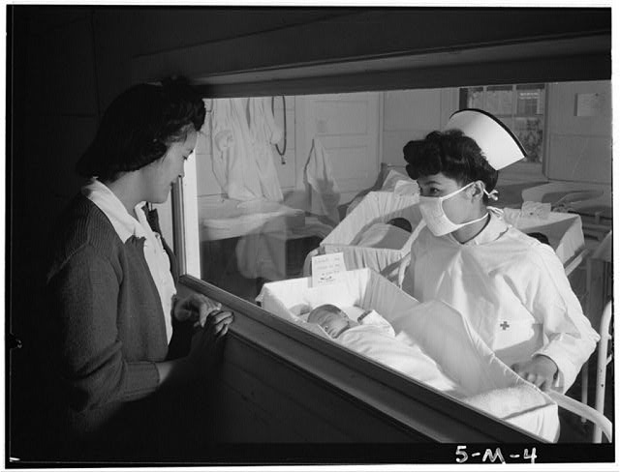
Title:Nurse Aiko Hamaguchi, mother Frances Yokoyama, baby Fukomoto, Manzanar Relocation Center, California
Photograph by Ansel Adams
Published[1943]
SummaryWoman looking through window at baby being held by nurse in maternity ward.

Slide 6
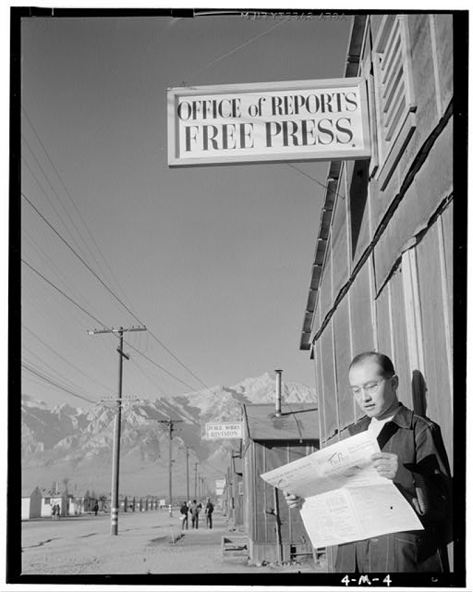
Title: Roy Takeno reading paper in front of office / Photograph by Ansel Adams.
Published[1943]
Summary: Roy Takeno reads a copy of the Manzanar Free Press in front of the newspaper office, mountains in the background.

Slide 7
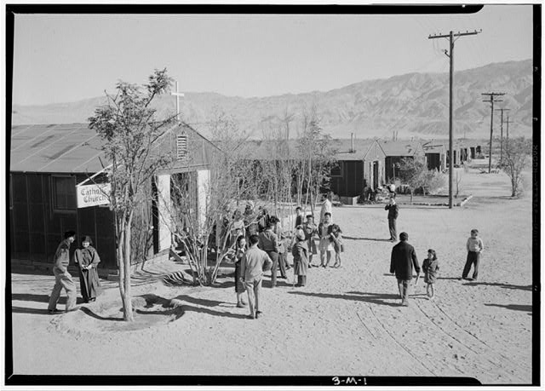
Title: Catholic Church, Manzanar Relocation Center
Ansel Adams 1943
People standing outside the church

Slide 8
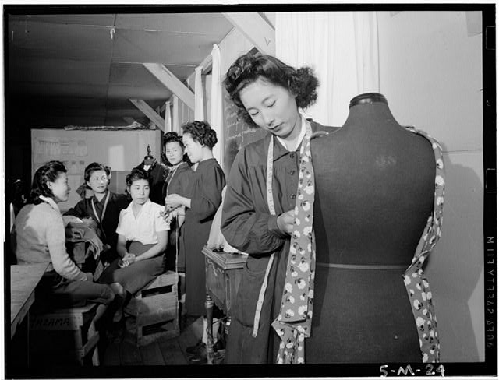
Dressmaking Class, Ansel Adams, 1943
Mrs. Ryie Yoshizawa, instructor, standing in front of class of women students, one woman in foreground with dressmaker's dummy.

Slide 9
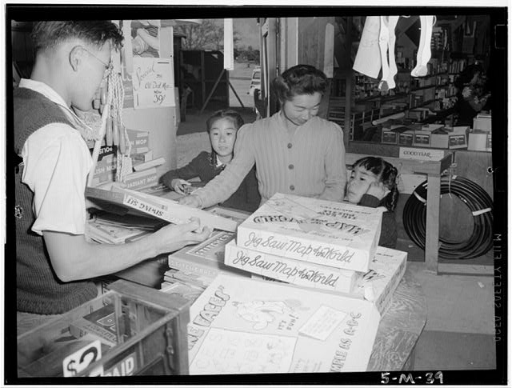
Mrs. Yaeko Nakamura and family buying toys with Fred Moriguchi, Manzanar Relocation Center by Ansel Adams--1943
Mrs. Yaeko Nakamura looks at puzzles with her daughters, Louise Tami Nakamura and Joyce Yuki Nakamura in a store with assistance from clerk, Fred Moriguchi.

Slide 10
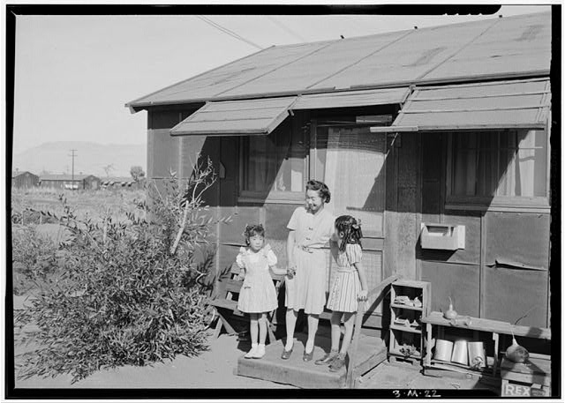
Mrs. Naguci and her two children Ansel Adams 1943

Slide 11
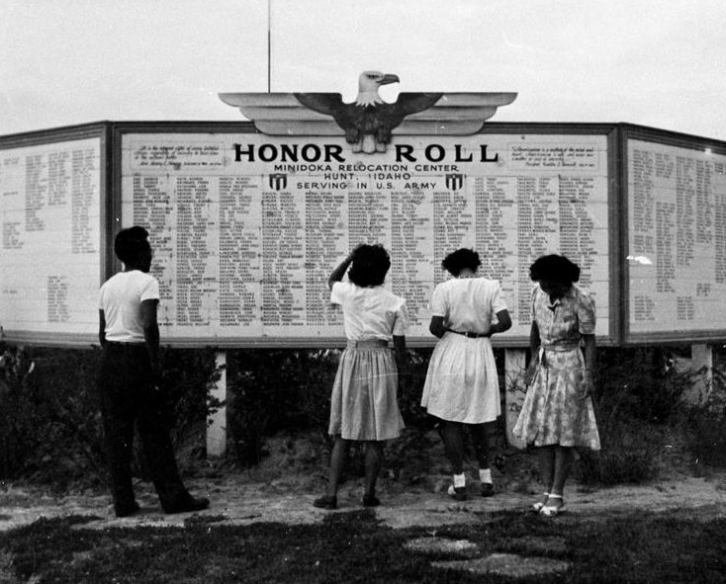

Slide 12
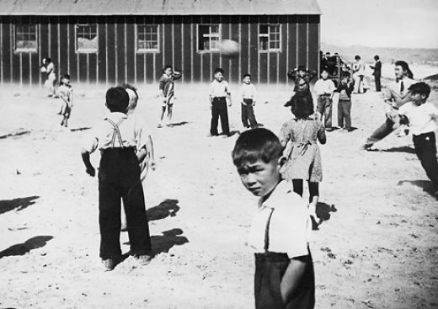

Slide 13
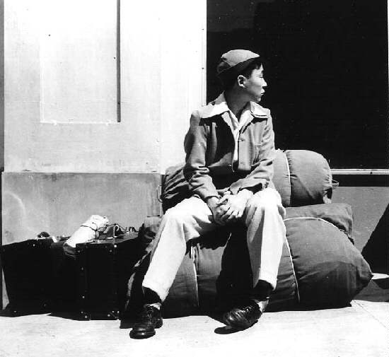

Slide 14
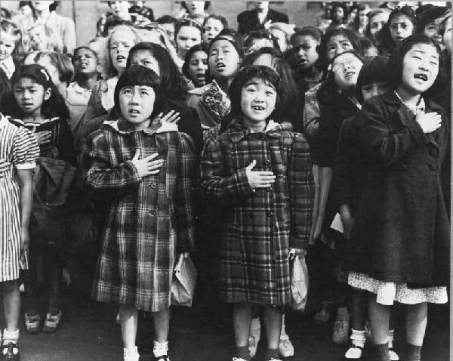

Slide 15
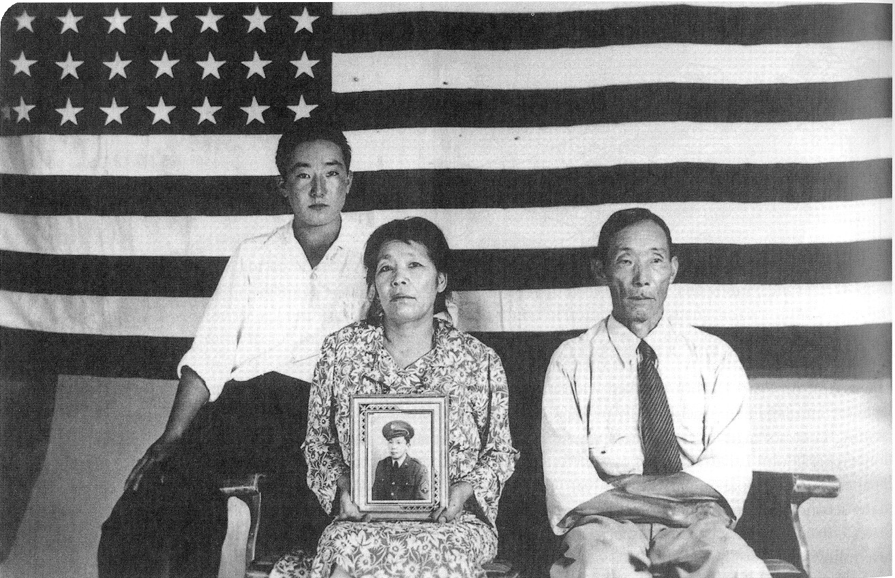
TAKEN BY: Dorothea Lange Hirano family at Poston Internment Camp

Slide 17
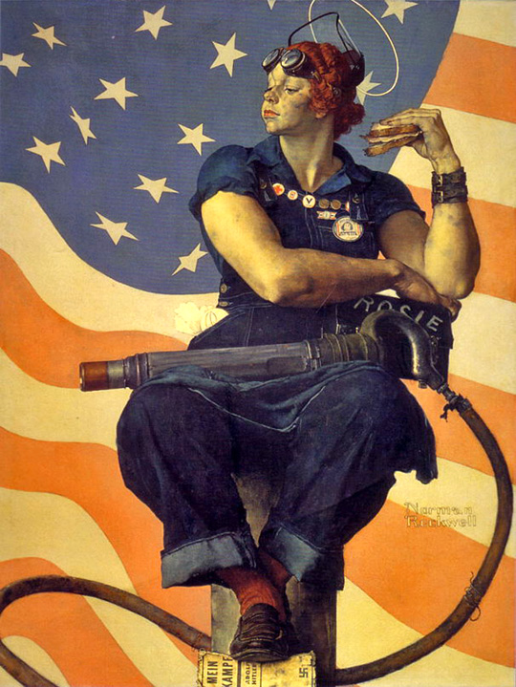

Slide 20
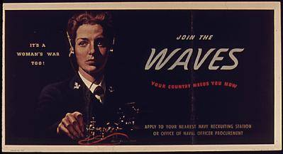
Notes:
World War II poster recruiting WAVES.

Slide 21
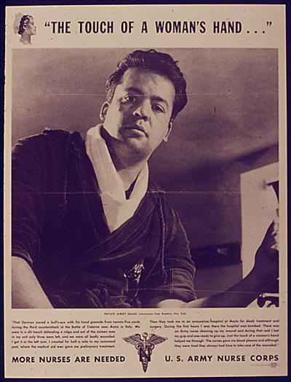
Notes:
World War II poster recruiting women for the U.S. Army Nurse Corps

Slide 22
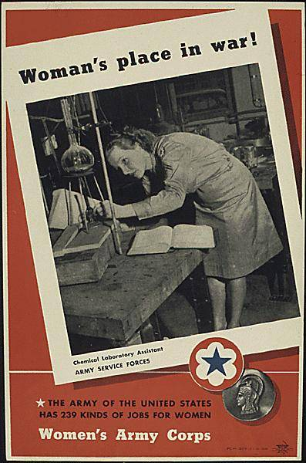
Notes:
Recruiting for the Women's Army Corps, chemical laboratory assistant in the Army Service Forces. "The Army of the United States has 239 kinds of jobs for wom

Slide 23
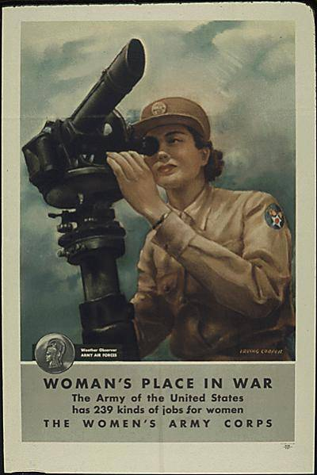
Notes:
Recruiting for the Women's Army Corps, weather observer in the Army Air Forces. "The Army of the United States has 239 kinds of jobs for women."

Slide 24
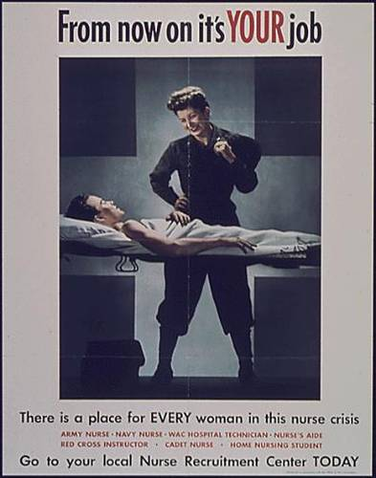
Notes:
Poster recruiting nurses for military service and homefront duties, part of World War II effort to recruit women in support roles.

Slide 25
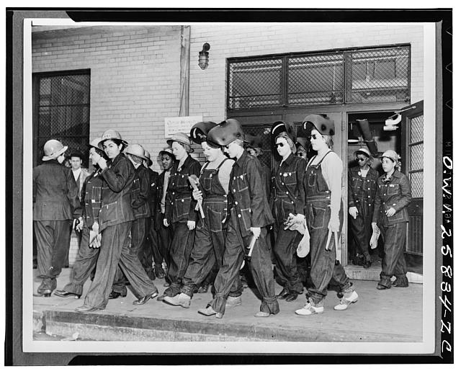
Women welders on the way to their job at the Todd Erie Basin dry dock
Notes:
Women welders on the way to their job at the Todd Erie Basin dry dock
Digital ID: (digital file from intermediary roll film) fsa 8e01109 http://hdl.loc.gov/loc.pnp/fsa.8e01109
Reproduction Number: LC-USW33-025834-C (b&w film neg.)

Slide 26
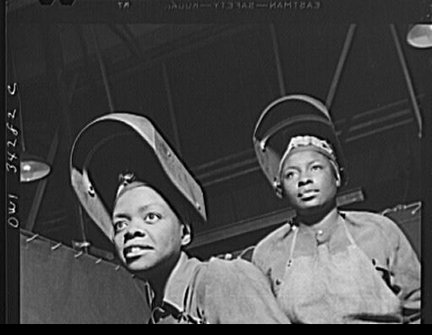
New Britain, Connecticut. Women welders at the Landers, Frary, and Clark plant
Notes:
New Britain, Connecticut. Women welders at the Landers, Frary, and Clark plant
Digital ID: (digital file from intermediary roll film) fsa 8d39781 http://hdl.loc.gov/loc.pnp/fsa.8d39781
Reproduction Number: LC-USW3-034282-C (b&w film neg.)

Slide 27
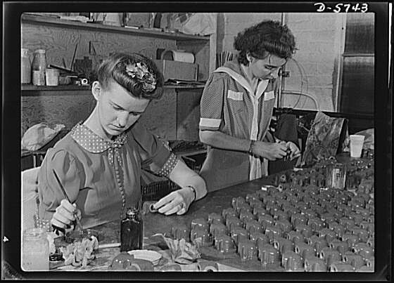
Notes:
Manpower. Handicapped workers. Auburn-haired, twenty-one-year-old, Belva Fletcher, left, handicapped by progressive paralysis, is still able to do a good job for Uncle Sam. With twenty-five-year-old Henriette Furley, she's painting Y's for airplane engines at the Maryland League for Crippled Children, where this work is done under subcontract to a Baltimore engineering company. Henriette is badly crippled by arthritis and must work standing because of the arthritic condition from which she suffers. White Engineering Company, Baltimore, Maryland
ATE: 1942 Aug.

Slide 28
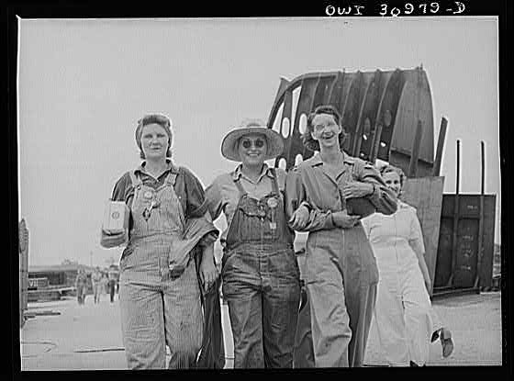
Notes:
CREATOR: Vachon, John TITLE: Women shipyard workers leaving the Pennsylvania shipyards, Beaumont, Tex. SUMMARY: Three women wearing overalls striding forward smiling, arms linked; another woman visible slightly behind them. DATE: 1943 May NOTE: Made for the Office of War Information. CALL NUMBER: FSA/OWI - H339157; also Microfilm LOT 713 REPRODUCTION NUMBER: LC-USW3-30979-D (b&w film negative) [also LC-USZ62-105157 (b&w film copy negative), made from another print]

Slide 29
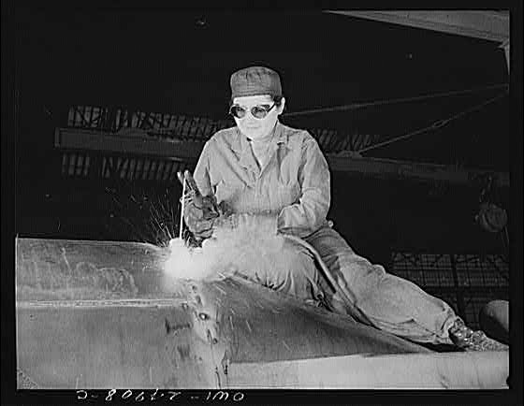
Notes:
CREATOR: Hollem, Howard R. TITLE: War production workers at the Heil Company making gasoline trailer tanks for the US Army Air Corps. Enola O'Connell, age 32, widow and mother of one child, welding part of a trailer. She is the only woman welder in the plant. This is her first job outside her house, Milwaukee, Wis. SUMMARY: Woman wearing coveralls and goggles, seated, using a welding torch. DATE: 1943 Feb. NOTE: Made for the Office of War Information. CALL NUMBER: FSA/OWI - F339157; also Microfilm LOT 710

